Slide 1
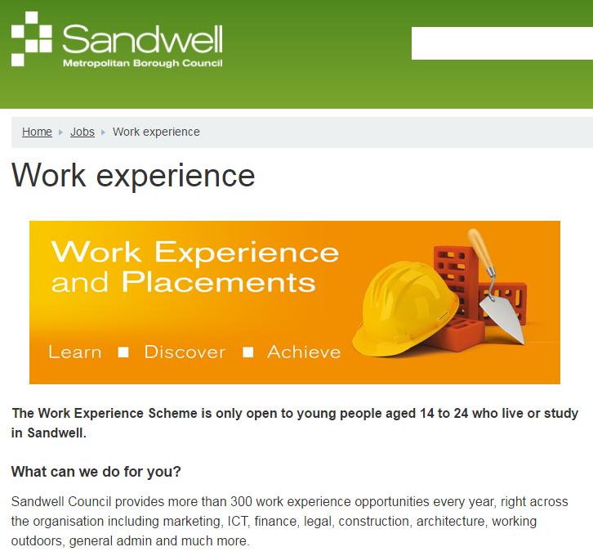

Slide 2
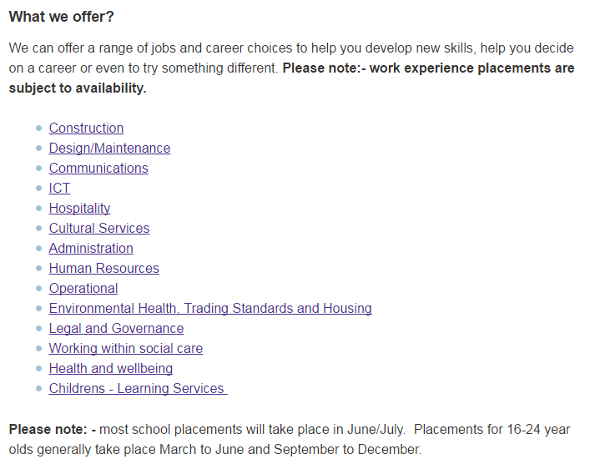


Slide 3
Birmingham Children’s hospital
Work Experience at Birmingham Women’s and Children’s NHS Foundation Trust (BWC) is a fantastic way of enhancing your knowledge about the different career opportunities available in the NHS and gaining valuable experience that can help you to make informed decisions about career choices.
At BWC, we can support individuals to undertake work experience in both clinical and non-clinical departments, and we ensure that individuals and departmental risk assessments and initial training needs if required are met prior to the commencement of the work experience placement.
Please be aware that completion of the application form for work experience placement does not guarantee a place on the programme, and we might not be able to match your requirements to the placements we have on offer.
Please contact bwc.workexperience@nhs.net for any information or work experience queries.

Slide 4
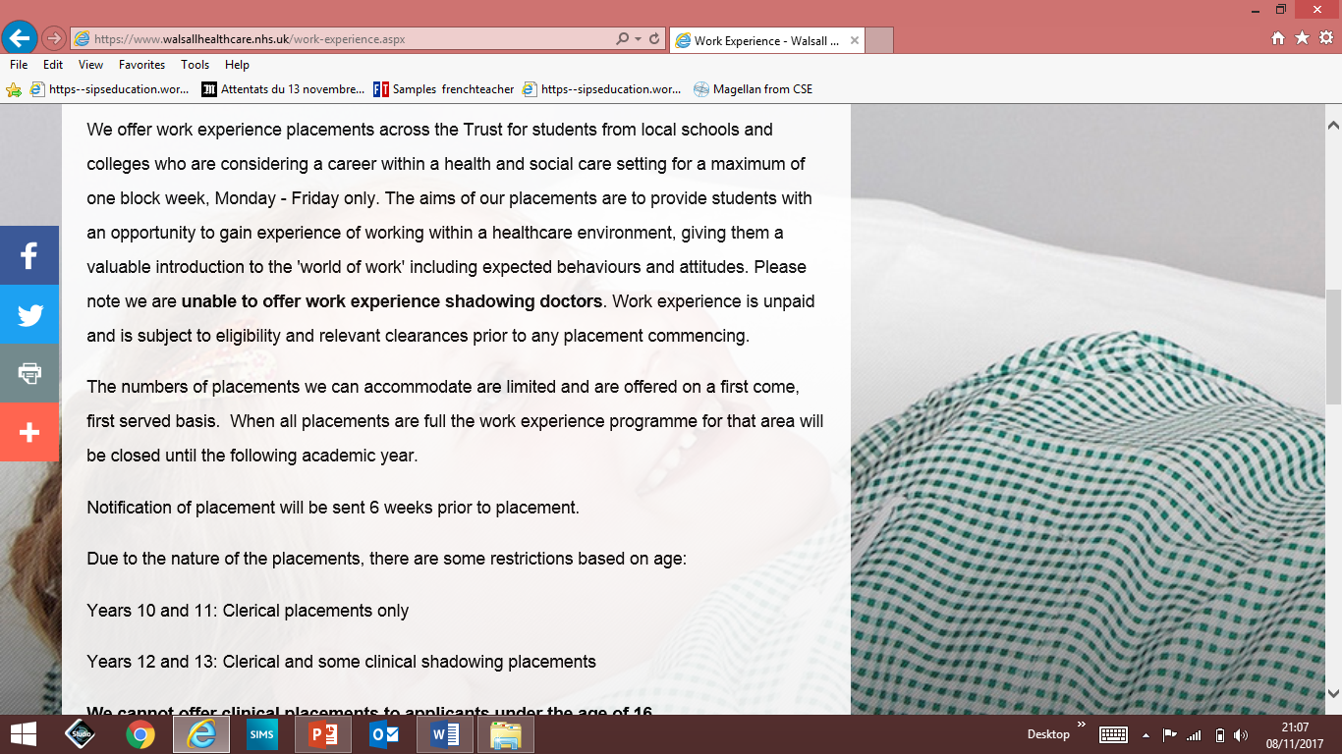
Walsall Healthcare NHS Trust

Slide 5
Walsall Healthcare NHS Trust
We cannot offer clinical placements to applicants under the age of 16.
Please note during your placement you will not be giving direct patient care.
Placements may be changed at short notice wherever possible we will offer you an alternative date / placement however this cannot be guaranteed
You may be asked to leave the work experience programme at any time if your behaviour is considered to be unsuitable.
Failure to provide evidence of immunisation will result in any placement offer being withdrawn.

Slide 6
Did you know there are over 350 different job roles within the NHS!
Many people consider the NHS as a clinical setting, with doctors and nurses and forget the “behind the scenes” people who all play an important role towards the functioning of the hospital and the care given to the patients.
We also offer placements within Allied Health Professionals roles. These are jobs within physiotherapy, occupational therapy, dietetics, speech and language therapy, orthotics, orthoptists, podiatry, the operating department or radiotherapy.
Clinical Placements can be offered to students aged 16+
Non-clinical placements (such as admin/IT) can be offered to students aged 14 & 15

Slide 7
Work experience is vital for young people from our local community giving them the opportunity to experience what it is like in a healthcare working environment.
This experience can help individuals decide on their future career pathway and assist with:
Broadening awareness of the numerous careers available within the NHS.
Developing an understanding of a chosen career.
Gaining transferable skills, such as communicating with others, that will be used within a wide range of job roles.
Experiencing how working roles within the NHS are often much more complex
Strengthening college, university or job applications by allowing an individual to discuss work experiences on application forms and at interview
Please note at this Trust, we prioritise applications from individuals who live in and/or attend an educational setting within the Sandwell and West Birmingham catchment area.

Slide 8
Risk Assessments and Health and Safety checks
Every place must be Health and Safety Checked and have a risk assessment.
Employers Liability Insurance. (why is this important?)
Every employer MUST have Employers Liability Insurance for you to do WEX.

Slide 9
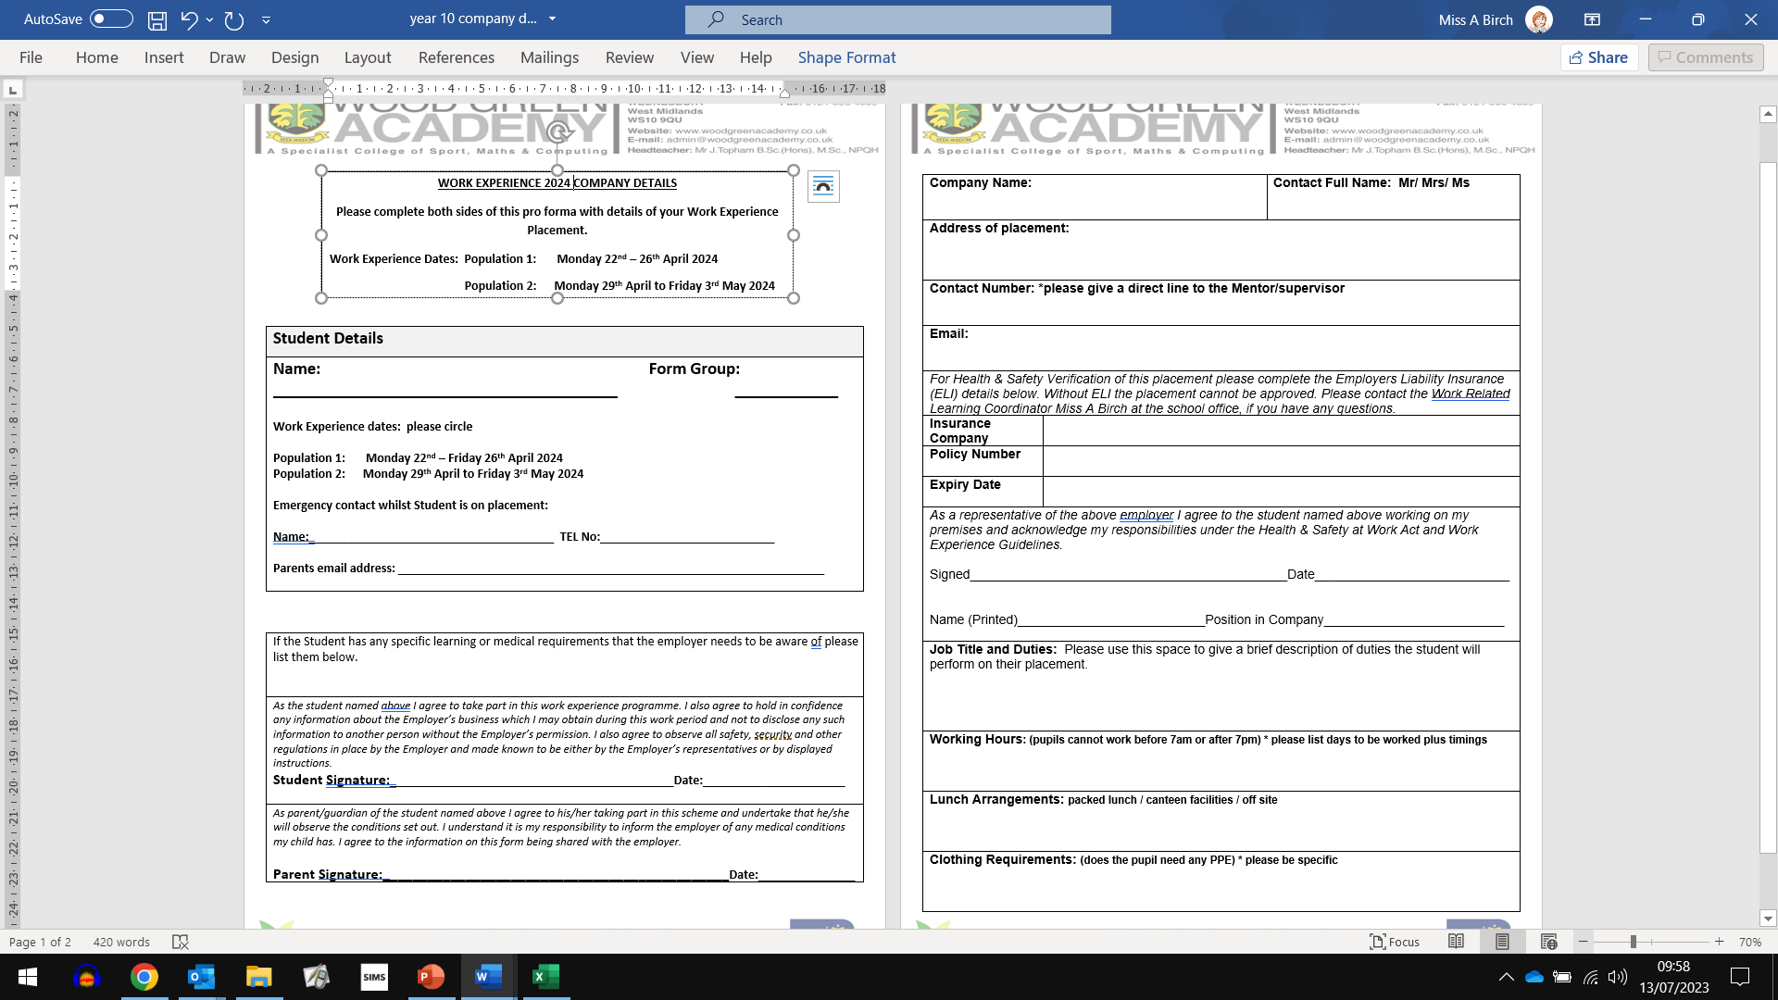

Slide 11
Deadlines for Paperwork
Deadline for completed (yellow) company details forms to be handed in to form tutors.
Friday 11th December 2026

Slide 12
WEX support in school
WEX support will be offered in school with Miss Birch in N108 at lunchtime.
Week 1: TBC
Week 2: TBC

