Slide 1
Sandwell RSE support for young people, professionals, parents/carers
29th January ‘25

Slide 2
About Brook
Established for over 55 years, Brook is the UK’s leading sexual health and wellbeing charity for young people.
We provide free and confidential relationships and sexual health services to under 25s throughout the UK at our Brook Clinics.
We also provide; counselling & wellbeing
services, sex & relationships education for young people, training for professionals, and accessible digital information at www.brook.org.uk.

Slide 3
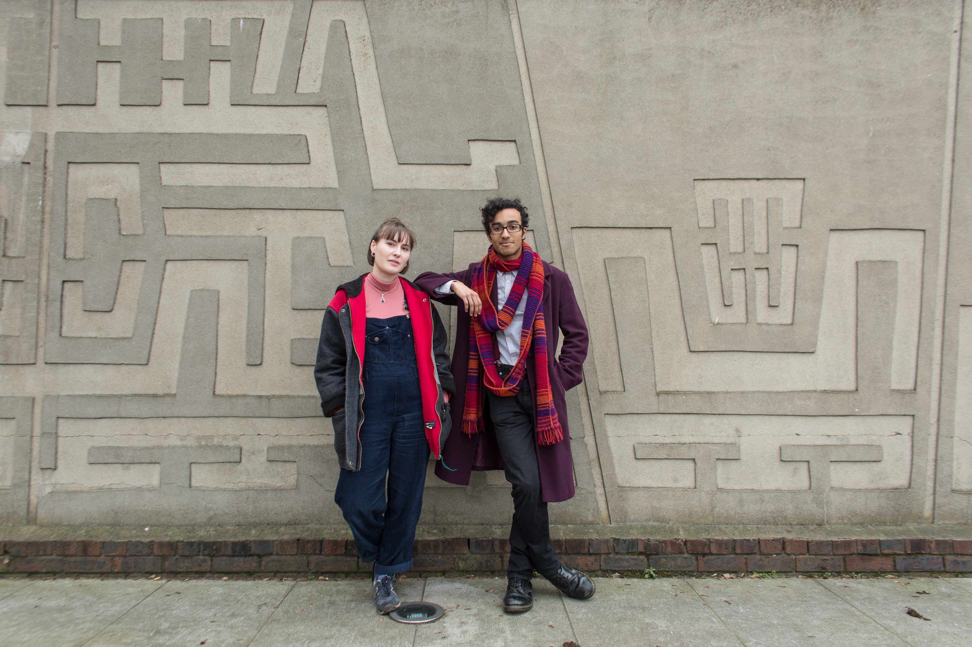
128,086 young people helped through our education & wellbeing work
128,032 young people helped through our education & wellbeing work
What is Brook?
What is Brook?
79% of young people rated our education work as ‘good’ or ‘very good’.
Young people rated our clinics 4.88 out of 5 stars
1.3 million young people helped face-to-face and online
1.4 million young people helped face-to-face and online
15,000 people took part in our Big RSE lesson.
Education programmes delivered in 35% of English local authorities
Notes:
Introduce Brook – some suggestions below
“In 1964, Helen Brook created a pioneering health service for young women who couldn’t access contraception anywhere else and desperately needed support. She refused to let stigma stand in the way of what was needed for these young women, despite fierce opposition.
Over 55 years later and Brook is at the forefront of providing sexual health services to young people. We support, educate and empower young people to make their own choices about their sexual health and wellbeing.”
Stats from Brooks Success report 2022 – number for the financial year 2021-2022
This shows we work with thousands of young people every year all over the country, supporting them with issues and questions they might have in around sex, their bodies and relationships
https://www.brook.org.uk/wp-content/uploads/2022/06/Brook_SR22_FINAL_LR.pdf
Our values are:
To be collaborative - We value young people’s right to be at the centre of decisions that affect them and work in partnership to provide opportunities to share their views, influence decisions and effect real change.
To be courageous - We relentlessly push the boundaries when fighting for change, supporting young people to build a society where people are free to explore their identities without stigma.
To be Trailblazing - Since 1964 we have championed the pioneering spirit of our founder, leading the way in meeting the ever-changing needs of young people.
To be Trustworthy- Young people rely on Brook’s confidential and non-judgemental approach to speak freely about the issues that affect them.

Slide 4
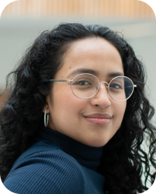

Overview of Offer
Sandwell Contract
  Tailored 1-1 RSHE support
  Targeted YP sessions in non-mainstream and alternative provisions
  YP Consultation and focus groups
  RSHE Parent/Carer sessions
  Parent/Carer Q&A sessions
  RSHE refresher e-modules designed and developed with PSHE lead (Emily Morgan)
  Professional trainings
  Public health Events
  Regular information e-bulletins

Slide 5
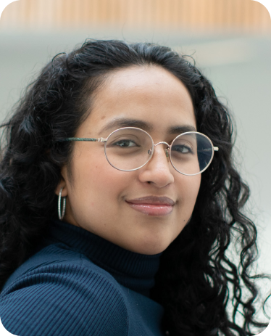
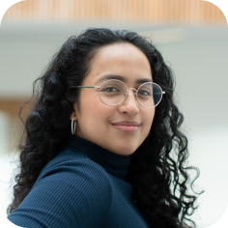
1-1 Targeted RSHE support
Link for referrals: https://forms.office.com/r/ijERZgg9vV
Sandwell contract
  We will continue to offer 1-1 support to YP referred into the service with a specific focus on targeted RSE
  Each YP will receive up to 6 sessions with an Education and Wellbeing Specialist
  Prior to the intervention every YP will attend an initial meeting with one of the team to agree and develop a Programme of Study. This will address the referral concern as well as provide any other education and support the YP wishes.
  The sessions will be scheduled for the times and days stipulated by the referrer in the referral form
  Please note that the sessions are voluntary and a YP has the right to withdraw consent to engage at anytime.
  Sessions are confidential unless a safeguarding concern arises

Slide 6
Targeted YP RSE sessions – LIMITED SESSIONS LEFT for this academic year
Sandwell contract
  We will work with 20 organisations and deliver RSE to the most vulnerable and at risk YP
  Each organization will be offered a maximum of 7 sessions and the session topics will be agreed and designed to meet the needs of the YP
  These sessions will be available to alternative and non-mainstream settings
  The topics offered are
  Puberty, sexual health, STI’s, contraception, pregnancy choices, accessing services, healthy relationships, consent, the right time to have sex, misogyny and sexual harassment, CSE. YPSI and pornography.
  If the group are SEND a group profile of the learners must be completed and reviewed by Brook before sessions can be agreed and planned. This is to ensure we are taking a stage rather than age approach

Slide 7
RSHE E-Learning modules
Sandwell contract
  We will work collaboratively with Sandwell PSHE lead (Emily Morgan) to develop refresher e-learning modules for schools to support with mandatory RSE delivery.
  More details of this will follow throughout the contract. Recordings of the e-learning modules are being scheduled this year and should be available to Sandwell schools towards the end of the academic year 25/26

Slide 8
Supporting Parents/Carers
Sandwell contract
  We will work with parents/carers to improve confidence and knowledge of RSHE and reinforce key messages in the home on relationships and sexual health outcomes
  We will offer 22 parent/carer sessions throughout the year. It is the intention that these will be face to face at times that are easily accessible (evening/weekends)
  In order to meet the needs of parents/carers we will be sending out a survey that can be disseminated to all parents/carers via schools, youth organisations and networks
  Examples of sessions that may be included are
  How to promote positive relationships and sexual health
  RSHE for YP with additional needs
  Debunking myths and taboos
  How to manage challenging and sensitive questions
  How to support RSHE curriculum being delivered at school
  We will also support parents/carers further by offering Q&A sessions at the end of each term to answer specific questions parents may have

Slide 9
Professional Training
Sandwell contract
  4 Traffic Light Tool – Delivered over Zoom. We have one session of Traffic Light Tool Training remaining, to deliver this academic year. If your organization would like to participate and has specific dates in mind. Brook will be able to discuss flexibility and can offer sessions face-to-face if there are 25+ attendees.
  We will be offering this online, in the event of no organizations requiring this delivery face-to-face. The booking link and date/time will be forwarded to Sandwell network at the end of February 2025 for professionals to book via Eventbrite.
  Please contact jane.mcnally@brook.org.uk to discuss booking this session for your organization or for the link to access the training in the event of any technical issues on the day.

Slide 10
Professional training
Sandwell Contract
4 Understanding Masculinity and Tackling Misogyny. Delivered over Zoom/face-to-face.
Fully booked
4 Sexual Harassment- Educating Young People and responding to Incidences. Delivered over Zoom or we can deliver to your organization face-to-face for 25+ attendees.
Two more available
  Please contact jane.mcnally@brook.org.uk if your organization wishes to complete this training and has specific dates in mind. Brook will be able to discuss flexibility and can offer sessions face-to-face if there are 25+ attendees.
  We have changed the strategy for bookings due to low attendance when advertised on Eventbrite. If schools/providers suggest preferred dates and guaranteed attendance we will organize sessions to suit professionals availability. Online training will be organized and forwarded to you if spaces are not taken by end February 2025.

Slide 11
Public Health Events
Sandwell contract
  We will attend 12 Public Health Events in Sandwell and hope to see many of you at these events!
  We will provide advice and guidance on sexual health, signpost to local services and YP over the age of 16 will have the opportunity to sign up to the C card scheme to access free condoms
  If you have any events organized that you would like Brook to be present to promote C-card and sexual health to 16-25 year olds. Please email jane.mcnally@brook.org.uk

Slide 12
Bulletins
Sandwell contract
  Bulletins will be sent out quarterly and will include
  Links to trainings
  Signposting to Brook website and Brook Learn
  Key legislation updates
  Relevant thematic and local information
  Promoted on local websites
  If we become aware of any information that requires urgent communication we will liaise with Emily Morgan and potentially send out an E-bulletin early.

Slide 13
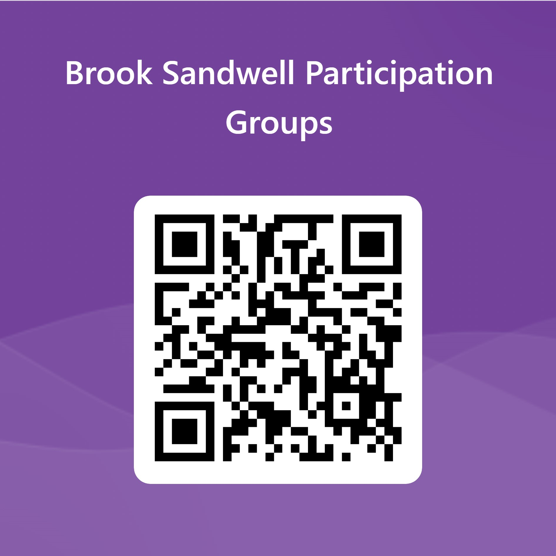
Thematic Projects
Sandwell contract
  LGBT+ Safe Spaces in Sandwell. We have successfully collected information from the LGBTQ+ community on how schools can improve safe spaces in the school environment. We are now looking for enthusiastic young people to join us for year 2, to meet and help feedback to the local authority how we can create safe spaces within the communities of Sandwell.
  This is a very exciting piece of work, and we want the voices of the YP of Sandwell to be heard in order to implement meaningful change.
  YP can apply to be part of the project by completing an expression of interest form using the link or QR code below. https://forms.office.com/e/yDGF3YFXTR

Slide 14
Outcome of lgbtq+ Year 1 project
Sandwell Contract
Year 1 outcome.
The project group explored what need to be addressed and improved for safe spaces in schools for the LGBTQ+ community. As a result, they worked with Brook and gave feedback on LGBTQ+ awareness training for professionals that Brook has designed. This training will be delivered FREE for Sandwell professionals on 3rd June 9am-12.30 at the Coneygre Centre, Tipton DY4 8UH. See link below.
Their hard work has helped produce an opportunity for professionals to gain free training from Brook to raise knowledge, confidence and awareness.
Training will be organized by Jane McNally and Emily Morgan. The training is free to Sandwell professionals and registration will be via Eventbrite. The spaces are limited to 60. Link to book for this training on Eventbrite below:
https://www.eventbrite.co.uk/e/lgbtq-awareness-training-tickets-1224590175179

Slide 15
Thematic Projects
Sandwell contract
Violence against Women and Girls (VAWG) Year 1 was launched in September 2024 and we are pleased to announce we now have 11 young people recruited on the project.
  This is a very exciting piece of work and we want the voices of the YP of Sandwell to be heard in order to implement meaningful change. We look forward to updating you later in the year with how year 1 of VAWG project has progressed.
  YP can apply to be part of the project by completing an expression of interest form using the link or QR code below.
  https://forms.office.com/e/yDGF3YFXTR

Slide 16
If you have any queries please contact us
Jane.mcnally@brook.org.uk
29/01/2025

